Slide 1

CHILD AND YOUTH RISK MANAGEMENT STRATEGY
2017/2018 INDUCTION
PROTECTING CHILDREN IS EVERYONE'S BUSINESS - PLAY YOUR PART!

Slide 2
Child and youth risk management strategy
THE FACTS
  Child abuse and neglect is one of Australia's most significant social problems*
  Almost 40% of SLSQ’s total membership are under the age of 18
  There were just over 10, 000 junior activities members registered with SLSQ at the end of 2016/2017 season
  Junior activities accounts for almost 33% of SLSQ’s total membership
  The Royal Commission is due to deliver its final report to Federal Government in December 2017. This report will make recommendations that aim to support governments, institutions and the general public in preventing and responding to child sexual abuse in institutional contexts. These findings may impact how surf lifesaving operates nationally.
  *National Association for Prevention of Child Abuse and Neglect
Notes:
http://napcan.org.au/about/
The Royal Commission into Institutional Responses to Child Sexual Abuse is investigating how institutions like schools, churches, sports clubs and government organisations have responded to allegations and instances of child sexual abuse.
The Royal Commission is about uncovering where systems have failed to protect children to make recommendation on how to improve laws, policies and practices. It can look at any private, public or non-government organisation that is, or was in the past, involved with children.
On 15 December 2017 the Royal Commission will present a Final Report covering its investigations to the Governor-General. The Final Report will make recommendations that aim to support and inform Australian governments, institutions and the general public in preventing and responding to child sexual abuse in institutional contexts.

Slide 3

Why have a documented risk management strategy?
    Commit to providing and promoting safe environments for children and youth
    Meet the legislative requirement - Working with Children (Risk Management and Screening) Act 2000 (the Act)
    Legally responsible as a committee member to:
      Act in the interest of the members, so should operate independently and free from influence
      Act in good faith
      Exercise due care & diligence
      Ensure solvency
      Meet legislative requirements.
    Surf Lifesaving is not immune to predators
Notes:
Safe environments don’t just happen they require ongoing planning, commitment, and maintenance. SLSQ is committed to providing and promoting safe environments for children and youth.
We believe that SLS must show a definite emphasis on this strategy by promoting and supporting its implementation at all levels.
Secondly, the Working with Children (Risk Management and Screening) Act 2000 (the Act) and the Working with Children (Risk Management and Screening) Regulation 2001 states that: as a regulated organisation we must have a risk management strategy in place.
On 1 July 2014, Blue Card Services transitioned from the Children’s Commission to the Public Safety Business Agency (PSBA), hence the Act and Regulation have changed.
Thirdly, each Club/ Branch committee member is bound by their legal responsibilities to ensure all of the above.
Lastly, we are not immune to predators.

Slide 4
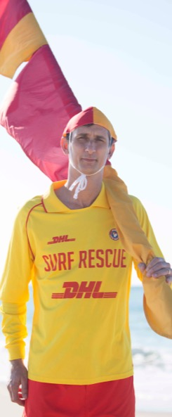
What are the Legislative Requirements?
    To comply with the legislative framework SLSQ, Branch and Club child and youth risk management strategies must:
    Address surf lifesaving’s commitment to creating a safe and supportive service environment within our organisation;
    Strengthen surf lifesaving’s capability to provide such an environment;
    Assist surf lifesaving to manage any particular concerns with respect to the safety and wellbeing of children and young people who are involved with the organisation or business; and
    Promote the consistency of surf lifesaving’s approach to risk management, both within the organisation or business and with respect to its compliance with the requirements under the Act.
Notes:
The Working with Children (Risk Management and Screening) Act 2000 and the Working with Children (Risk Management and Screening) Regulations 2011 require regulated organisation’s and businesses to develop and implement a child and youth risk management strategy which aims to keep children and young people safe.

Slide 5
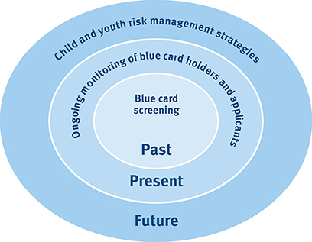
How do we meet the requirements?
Notes:
https://www.bluecard.qld.gov.au/
SLSQ provides modifiable templates as part of its Child and Youth Risk Management Strategy (CYRMS) to meet the legislated requirements so that there is a consistent approach in all clubs and branches to the protection of children and youth. The strategy allows individual organisations to adopt changes based on their circumstances, operating environment and governance structures.
The strategy is the overarching tool to prepare clubs and branches to manage risks that have the potential to occur. An annual review of this strategy must be conducted.
The blue card system then fits within the strategy by risk managing the initial assessment, which determines a person’s eligibility to work with children, based on known police or disciplinary information (the past).
Once obtained, blue card or exemption card holders are risk managed through police information of all, which is continuously monitored so any changes are actioned appropriately (the present).

Slide 6

Where can the Legislative Requirements be found?
    There are eight minimum mandatory requirements as per the Working with Children (Risk Management and Screening) Act 2000 that must be included in a Child and Youth Risk Management Strategy.
    All templates to meet each of the below are available for download from the Members Portal - Member and Club Development - Member Protection – QLD – Child Youth Risk Management Strategy and COMING SOON – SLSQ App!
    Commitment
      A statement of commitment
      Codes of conduct
    Capability
      Recruitment, selection, training and management strategies
Notes:
The Working with Children (Risk Management and Screening) Act 2000 and the Working with Children (Risk Management and Screening) Regulations 2011 require regulated organisation’s and businesses to develop and implement a child and youth risk management strategy which aims to keep children and young people safe.
All of the updated forms/ templates are now available for download from the Library in the Members Portal (https://portal.sls.com.au). Folder ref: Member and Club Development - Member Protection – QLD – Child Youth Risk Management Strategy.
COMING SOON -SLSQ will also release an App resource library and all CYRMS templates and information will be found on this . More information to come.

Slide 7

Where can the Legislative Requirements be found? Cont…
    Concerns
Policies and procedures for handling: ​
  disclosures and suspicions of harm;
  breaches​; and
  planning process for activities and special events.​
    Consistency
      Compliance with the blue card system
      Strategies for communication and support
    (Reference the Learning Portal on Youtube for further information on each requirement)
Notes:
Blue Card Services - Queensland Government have developed a Learning Portal - Risk Management, with 10 videos to assist organisations to understand their obligations under the blue card system, in particular, how to develop a child and youth risk management strategy.
https://www.youtube.com/playlist?list=PLO6A_tBOk8z2jb3hG8OzP1DkfPtFsMF55

Slide 8
Changes to the strategy for 2017/2018
    UPDATED
      SLSA Member Protection Policy 6.05 – as at October 2016
      SLSQ MS06 Blue Card Screening Policy – as at 1 July 2017
      SLSQ MS03 Dealing with Police Investigations Policy – as at 1 July 2017
    NEW
      Blue Card Forms – as at 1 July 2017
    UPDATED
      Summary for Clubs to Manage Child & Youth Protection
      Information Sheet for Parents/ Carers Template
      Blue Card Scenarios Factsheet
      Procedure - Screening Checklist for Organisations Authorised Persons (useful for club administrators/ authorised persons to ensure that forms are completed correctly to ensure fastest turn around possible on blue card approvals).
      Member Protection Field Explanation in SURFGUARD.pdf (*Fields have changed in SurfGuard* this sheet outlines what each member protection field in Surfguard means in a member’s profile)
Notes:
The new & updated information is all available on the SLSA Members Portal (https://portal.sls.com.au) as following:
Blue Card Forms –
(Folder ref: Library – Member and Club Development - Member Protection – QLD – Blue Card Forms)
Templates/ Policies etc. updated on the Members Portal (Folder ref: Library – Member and Club Development - Member Protection – QLD – Child Youth Risk Management Strategy)
COMING SOON – SLSQ will release an App in August which will house all Membership Resources!
All of the CYRMS documentation will be available on there for clubs/ members to download and review as required.

Slide 9
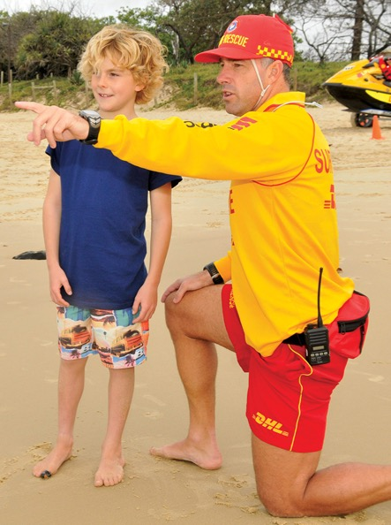
Most important
  The following documents are most important for practical use:
      Summary for Clubs to Manage Child & Youth Protection;
      Flow chart for Reporting Youth Protection Complaint; and
      How to deal with receiving Youth Protection Complaint
      Procedures for Management of Blue Cards – what to do when a person’s card expires, is withdrawn, discontinued, suspended or cancelled.
Notes:
The most important documents in the strategy for clubs/ branches to cover are listed here and we will quickly look at each one in more detail in the following slides.
The best way to look at this from the organisations perspective is to go through each step by step.
The documents could also be included in members handbooks, newsletters, noticeboards, or other places where people would read them.

Slide 10
Summary for Surf Clubs to
Manage Child and Youth Protection
This document gives guidelines on:
    Dealing with children and youth (Coaches, Trainers, Age Managers and Officials)
    Activity inductions
    Communication (face to face and electronic)
    Physical contact during training
    Change room arrangements
    Children with Special Needs/ Cultural Considerations
    Transport - drop off and pick up
    Overnight & off premises trips/ activities
    Images
Notes:
As a support strategy for Junior Activities & Youth Activities, SLSQ has provided the following directions which must be widely distributed to relevant personnel & be used by Clubs to assist with their operational procedures surrounding child & youth protection.
Surf Life Saving Clubs must always consider their own particular circumstances, identify and assess risks and implement appropriate risk management strategies. The following are strategies only and are not legal advice. Please review these directions to ensure that they match club protocol and promote this information in club handbooks, inductions, on websites or in other communication formats as required to make sure that all are aware of the club procedures.
All members must:
• Remember that the welfare of the child or children is always of paramount importance.
• Know the policies, complaint processes and guidelines under 6.05 SLSA Member Protection Policy and how they apply to you.
• Understand and commit to SLSQ Codes of Conduct.
• Understand how the child protection legislation in Queensland affects you.

Slide 11
Notes:
Clubs must have a process for dealing with various types of complaints/ grievances or general issues.
We have created a template within the strategy - Flow chart for Reporting Youth Protection Complaints that clubs can use/ modify for their particular process.
SLSA are also developing an online complaints form – coming soon.

Slide 12
Notes:
This flow chart explains - How to deal with receiving Youth Protection Complaint.
SLSQ - MS04 - Receiving and Reporting Disclosures or Suspicions of Harm Policy - aims to assist members/ staff when confronted with disclosures or suspicions of harm, to children and young people. It will enable staff/ members to respond professionally, and as quickly as possible, and in the best interests of the child or young person, under the age of 18, who is the subject of alleged harm. SLSQ recognises that children and young people are vulnerable members of the community and that extra measures must be taken to protect and support them.
Please refer to this policy for further information on definitions and recommendations.

Slide 13
Blue Card Policy Procedures
Positive Notice
Enter person's positive notice information in Surfguard
(CEO/ Appointee)
Person is allowed to begin working in Regulated Employment
Place member on "Restricted Activities" (Club President)
Negative Notice (other than disqualifiying offfence)
Letter sent directly to person & Club President (CEO/ Appointee)
Person is prohibited from working in Regulated Employment
Automatic "Suspension" by CEO, on Surfguard
Letter sent directly to person & Club President (SLSQ CEO).
SLSA Advised
CEO or appointee to act according to SLSQ Policy MS03
Withdrawal
Automatic "Suspension" by CEO, on Surfguard
Letter sent directly to person & Club President (SLSQ CEO)
Letter sent directly to person & Club President (SLSQ CEO).
SLSA Advised
Person is prohibited from working in Regulated Employment
Change in Police Information
Letter to Club Member and President (CEO/ Appointee) to advise a change in Police Information has been received
Return completed Change in Police Information Form to SLSQ (Member)
Await advice from Blue Card Services to see if member can still volunteer in regulated employment
Cancellation
Place member on "Restricted Activities" (Club President)
Negative Notice (Disqualifiying Offence)
Automatic "Expulsion" by CEO, on Surfguard
CEO or appointee to act according to SLSQ Policy MS03
Letter sent directly to person & Club President (SLSQ CEO).
SLSA Advised.
Person is prohibited from working in Regulated Employment
Person is prohibited from working in Regulated Employment.
If convicted, Life Membership is automatically revoked.
Place person on "Leave/ Restricted " on Surfguard (SLSQ Appointee)
Discontinuance
Place member on "Restricted Activities" (Club President)
Place person on "Leave/ Restricted " on Surfguard (SLSQ Appointee)
Letter sent directly to person & Club President seeking formal response from President regarding the person's involvement in regulated employment (CEO/ Appointee).
If engaged in regulated employment as per section 4.2, person is prohibted from working in Regulated Employment.
Upon receipt of letter from BCS the person is managed as per the flow of Negative Notice, when necessary.
If not engaged in regulated employment as per section 4.2, person is removed from "Restricted Activities", and "Leave/ Restricted" on Surfguard.
Notes:
Refer to the SLSQ Blue Card Screening Policy – Appendix A
The recent update of the policy outlines the outcomes should a person’s Blue Card expire, be withdrawn, discontinued, suspended or cancelled. There may be ramifications regarding continuing employment / volunteering with a surf life saving activity/ organisation, such as being placed on leave restricted duties, suspension, or immediate expulsion of membership.
SLSQ and its affiliated or recognised entities must take steps to ensure that the person is no longer engaged in regulated employment by following procedures outlined in Appendix A – Blue Card Policy Procedures.

Slide 14
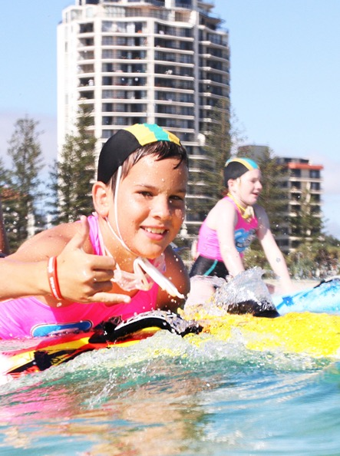
Who can Help
  Brad Skinner – Grievance Officer
  Jason Wells – Club Captain
  Darrin Bragg - Club President
  Liz Kerr – JAC
  Shannon Morgan – Youth Development
Notes:
Club to add contact information for the specific position holders who are responsible for elements of the strategy:
Grievance officer
Club Captain
President
JAC
YMDO etc.

